Slide 1
Sales & Discount Insights – January vs March 2024
Supplier activity, product performance & strategy reflection

Slide 2

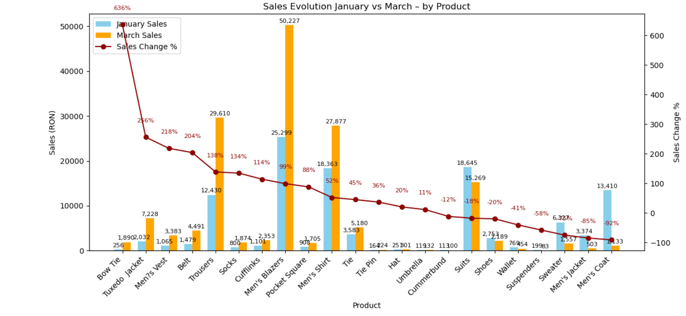



Sales Evololution by Product (Jan vs Mar)
Key insights:
Men’s Trousers: Up to 140% from January to March (12,430 RON in Jan -> 29,610 Ron in March.
Tuxedo Jackets: Up to100%+ increase (3,383 RON -> 7,728 RON)
Bow Tie: From 256 RON in Jan to 1890 RON in March (approx. +638%)
Conversely Men’s Jacket and Coat sales dropped significantly.
These shifts could reflect growing demand for formal or event-specific wear.

Slide 3
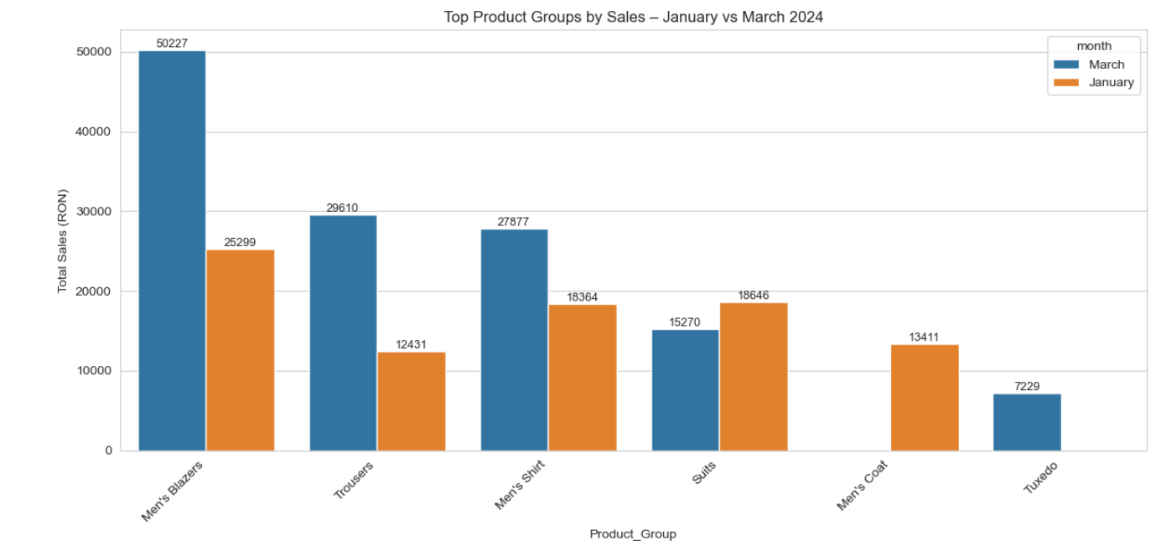
Top Product Groups by Sales (Jan vs Mar)
Key Insights:
Men’s Blazers ranked #1 in January (25,299 Ron) and almost doubled the sales in March (50,227 Ron)
Men’s Shirt dropped to #3 in March after the Trousers sales increased with approx. 138.2%.
Men’s Coat dropped from Top 5 in January to off the chart in March; Tuxedo entered instead.
Note: This may reflect changes in stock, promotion strategy, or seasonality.

Slide 4
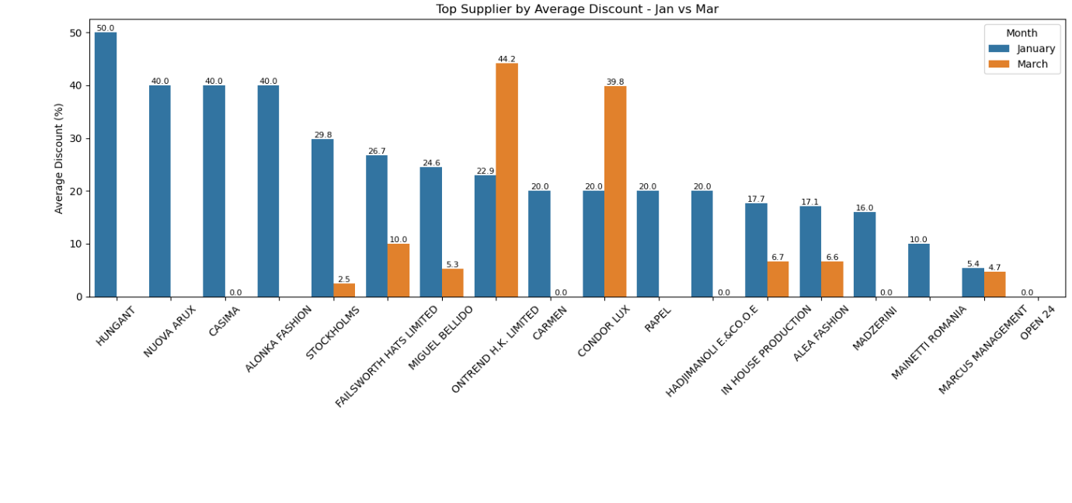
Supplier Discounts (Top suppliers – Jan vs Mar)
Key Insights:
HUNGANT & NOUVA ARUX maintained avg . Discounts of 50% and 40% in both months.
Suppliers like Alonia Fasion, Cochnou’s and Stockholms dropped from 40% to 0%.
In total, 6 suppliers eliminated all discounts by March.
NOTE: Removing discounts may reduce sales unless backed by product appeal or exclusivity.

Slide 5
Conclusion & Recommendation
Conclusion
Recommendations
Sharp rise in formalwear sales (+100% to +600%) hints at increased event-driven demand.
Product group rankings shifted significantly – some items gained traction, others faded.
Discount consistency helped maintain sales volume ; sudden removal impacted some suppliers.
Monitor sales trend post-March to validate if formalwear trend continues.
Test promotional campaiings on top-selling groups (e.g., Shirts, Trousers).
For suppliers removing discounts:
Evaluate if sales held or dropped. Consider controlled discount strategies instead of abrupt stops.

